Slide 1

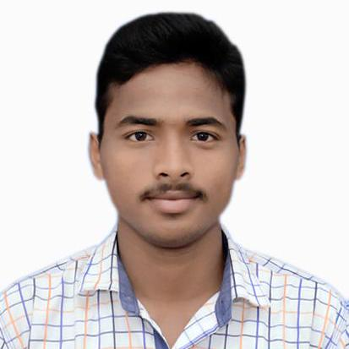



Bijay Kumar Pradhan
Education and certificates Master in Computer Application: 2018 - 2021
Skills
Analyst/Software Engineer
Base Location: Bengaluru
Email ID: bijay-kumar.pradhan@capgemini.com
Mobile No: +916372196327
Grade: A4
Java | Java Basics,OOPS,Generics, Collections, Array.
Spring | Spring MVC, spring boot framework.
React | Components, Hooks, Virtual DOM, Routing, Forms & Validation
Database | Oracle
UI Tech | HTML 5 & CSS 3,JavaScript, ES6 & React
Cloud | AWS cloud practitioner Google Cloud Platform
Tools | Git, Swagger,STS, Visual Studio Code.
Add On skills | Immersive Learning and Java
Strengths
Full Stack Developer
Hands on experience on Java, Spring framework, oracle, spring MVC with WEB API.
Proficient in creating Single page Web Application in React with Authentication with routing
Hands on experience in developing web pages using HTML5, CSS ,React, Good understanding of Document Object Model (DOM) and DOM Functions
Ready to learn new technologies and implement them for the Future Knowledge improvement.
Achievement
Education System
Case study of Education System along with API Gateway, Swagger , Spring Boot , responsive UI with HTML5, CSS, Bootstrap and React used as User Interface
.
Agriculture Crop Deal System
Case study Agriculture Crop Deal along with API Gateway, Swagger, Spring Boot microservices, spring security , responsive UI with HTML5, CSS, Bootstrap and React used as User Interface.
Degreed :Successfully completed the degreed training in git, Mongo Db, core java, spring boot, React.
Check out my work on GitHub
Presentation Title | Author | Date © Capgemini 2017. All rights reserved | 1

